Slide 1
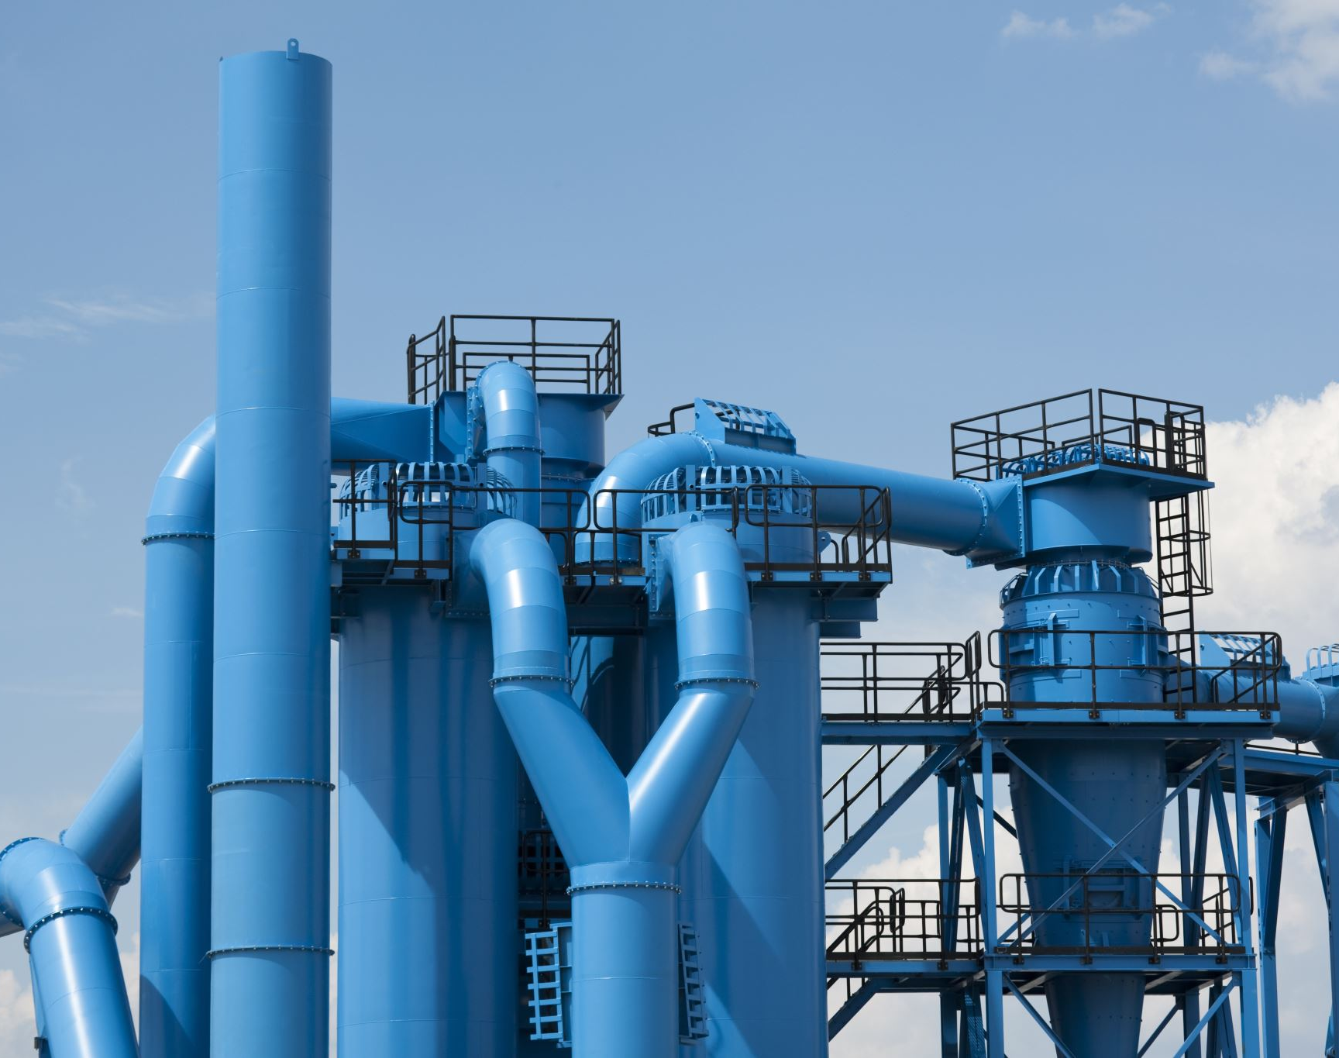
Water Treatment Plant
Unity 3D

Slide 2
Project Background
Simulate
visualize

Slide 3




Tools & Software
1
3
Maya
Krita
Visual Studio
Unity
2
4

Slide 4
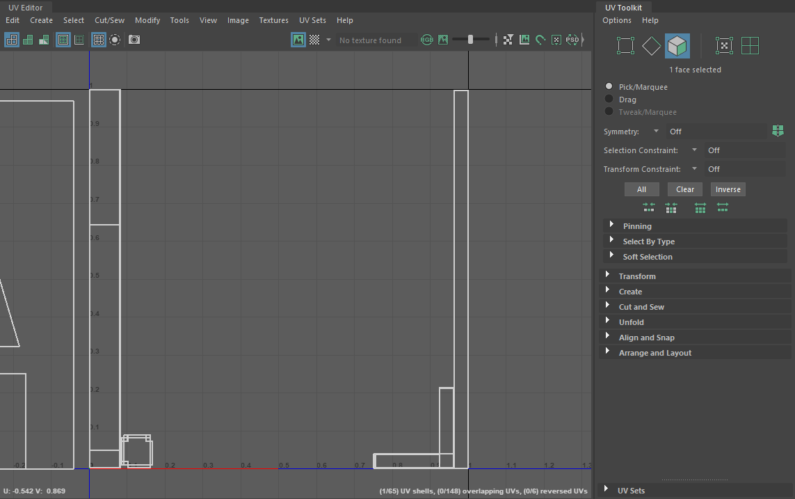
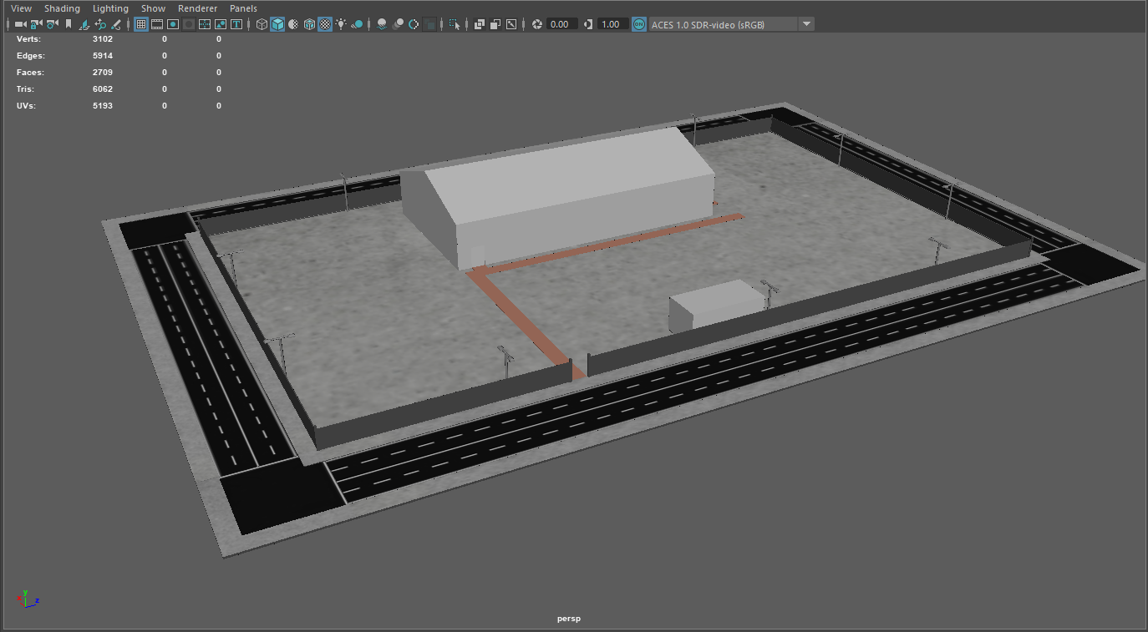
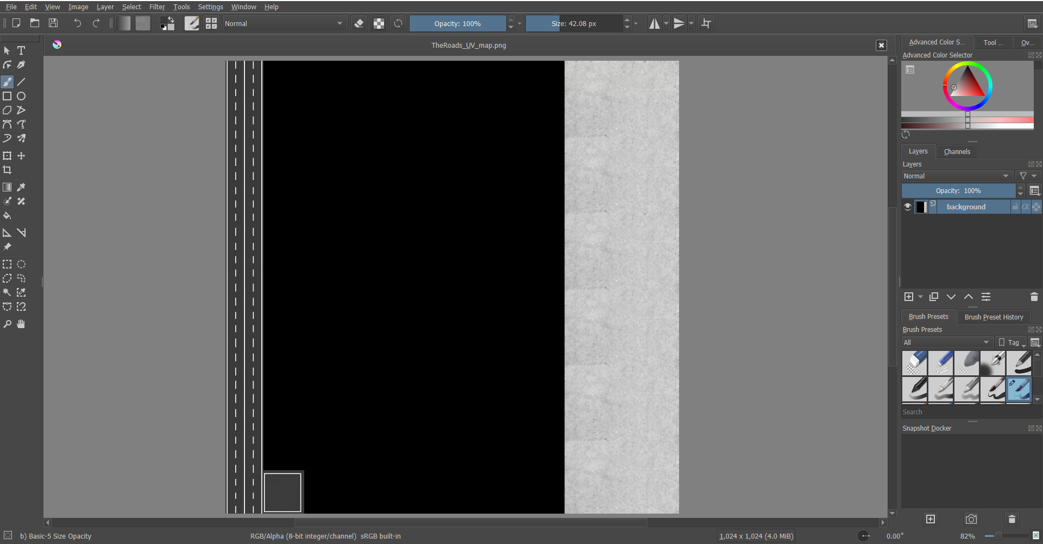
Modeling & Texturing
Maya
3D Models
UV Mapping
Krita
Texturing

Slide 5
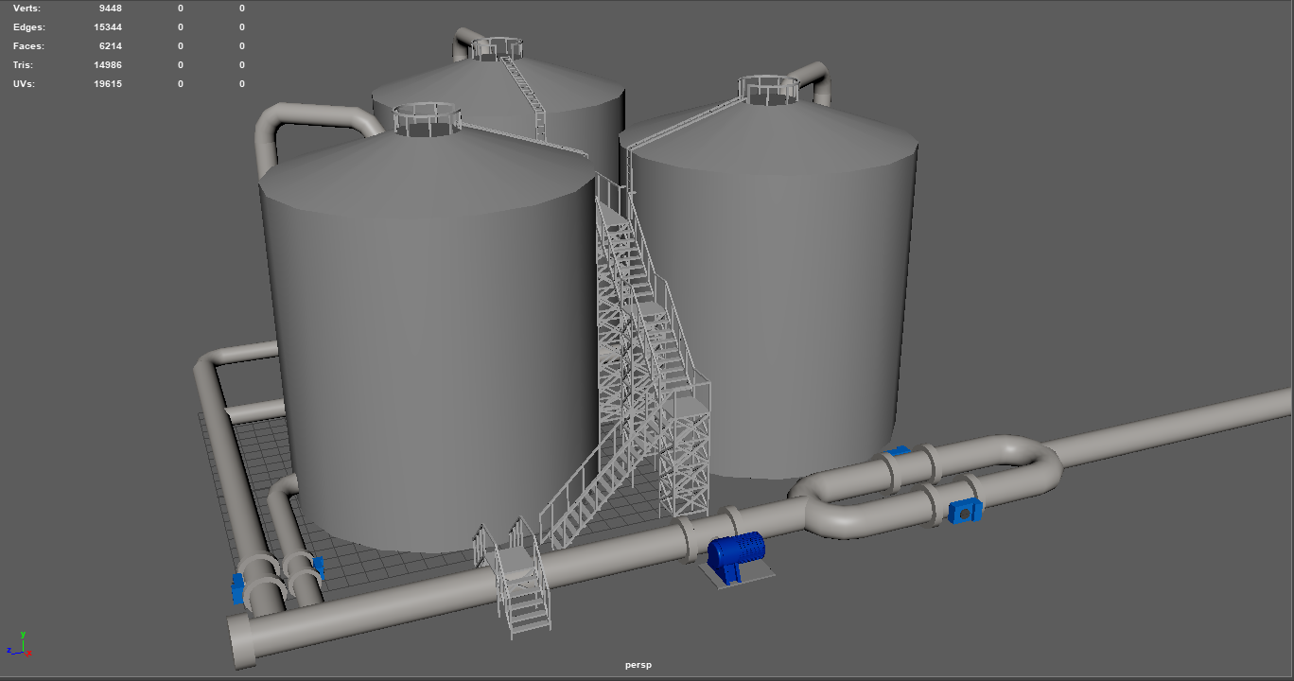
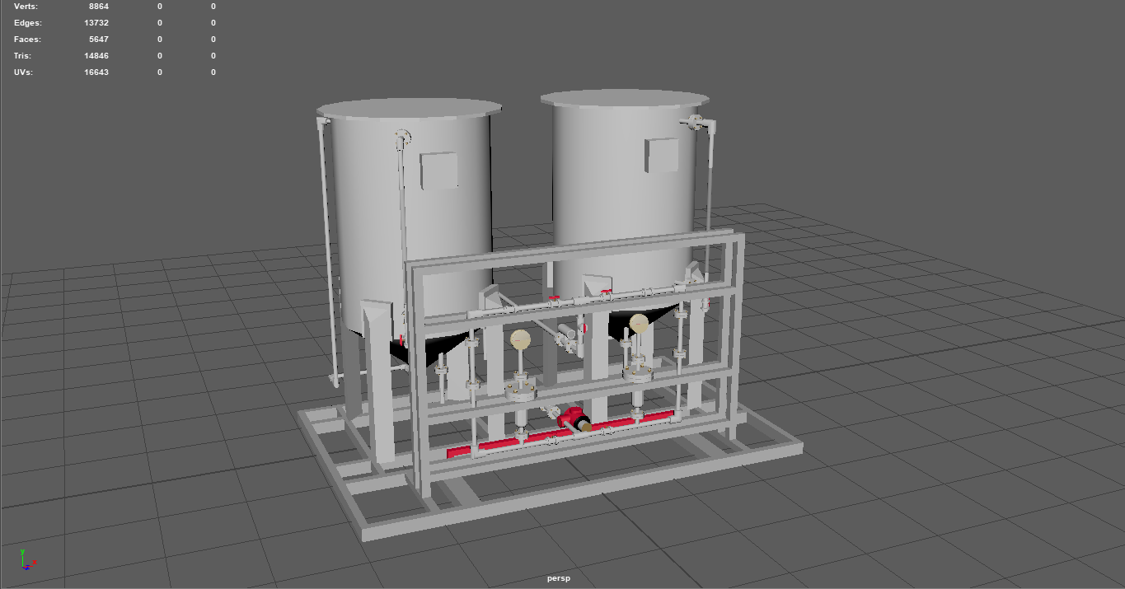
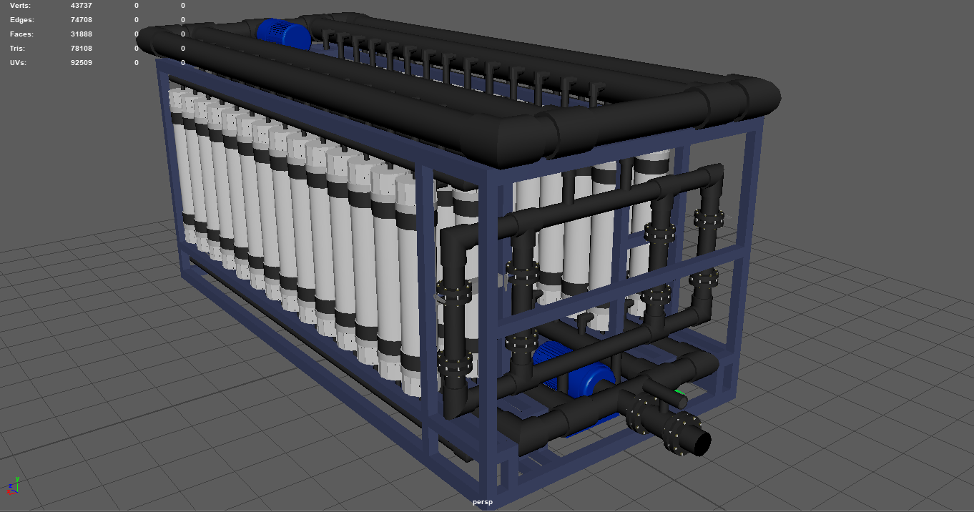
Main 3D Models
Wastewater Tank
Chemical Dosing
Ultra-Filtration

Slide 6
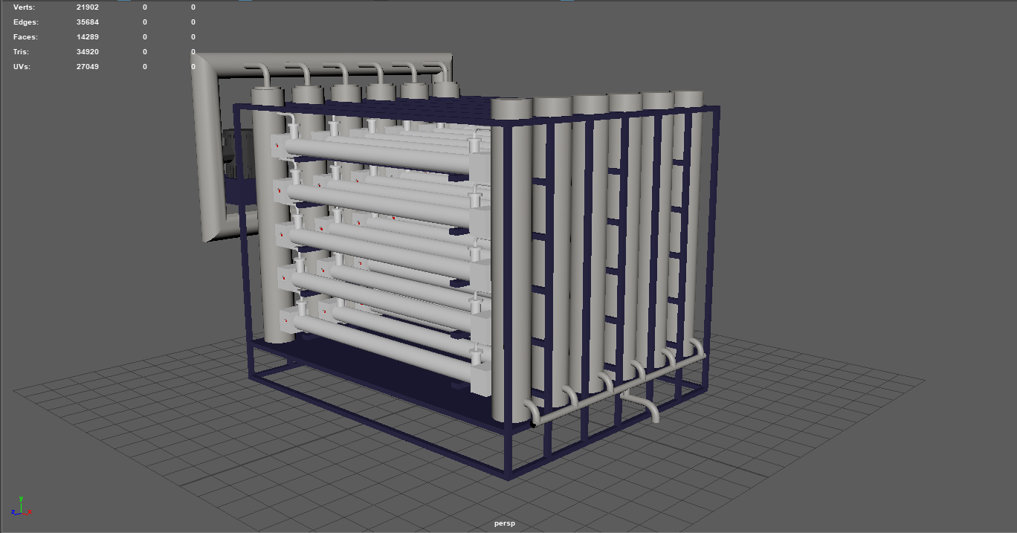
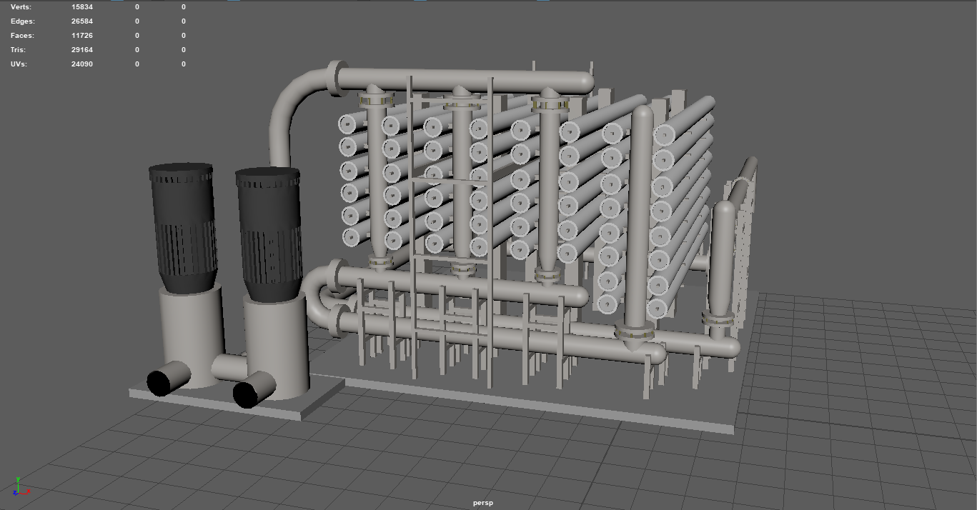
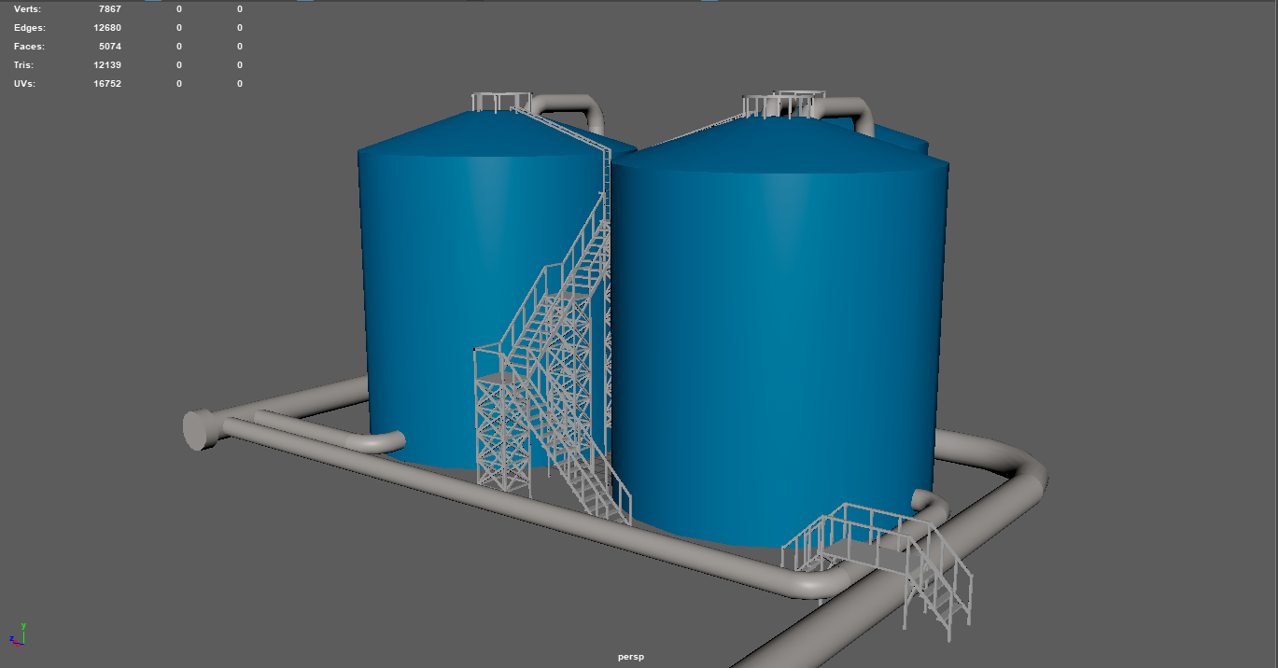
Main 3D Models
De-Chlorination
Reverse Osmosis
Discharge Tank

Slide 7
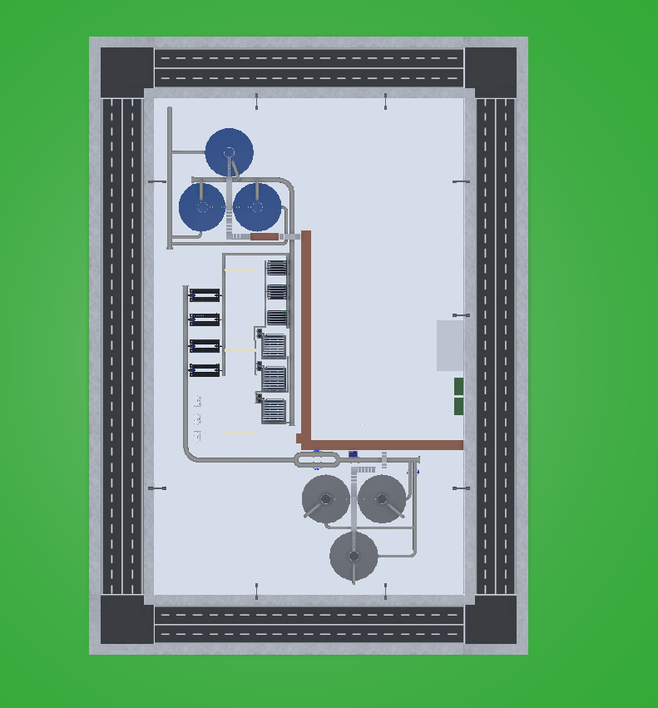
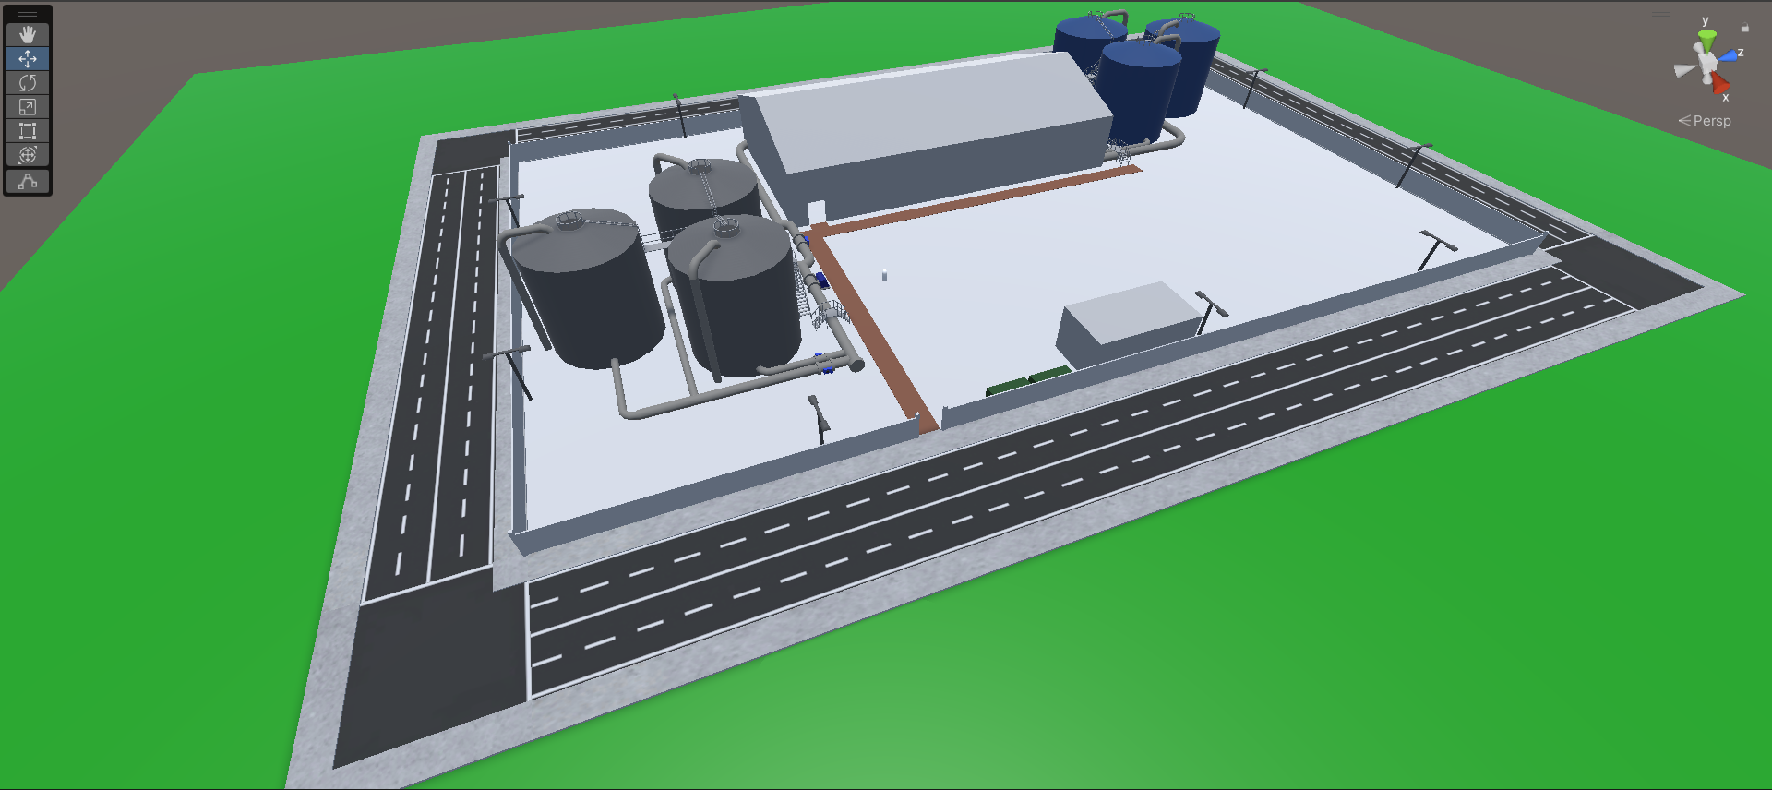
Unity (Layout)

Slide 8
Unity (Flow Process)
2
3
6
5
4
Wastewater Tank
Chemical Dosing
Ultra-Filtration
De-Chlorination
Reverse Osmosis
Discharge Tank
1

Slide 9
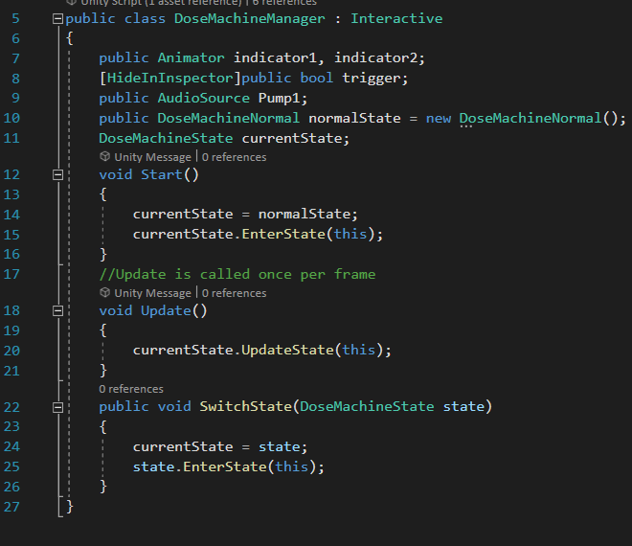
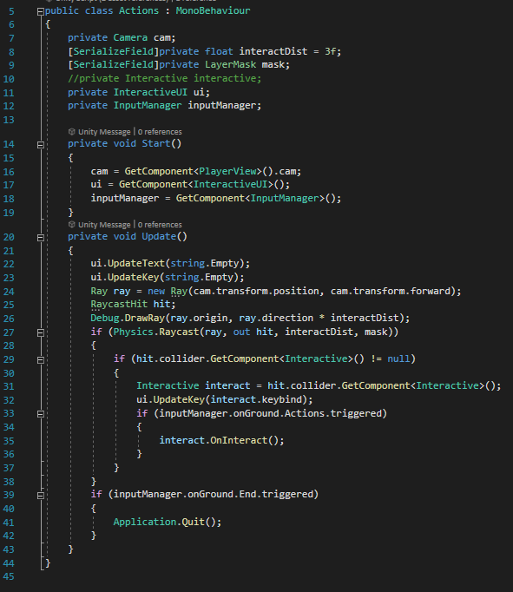
Programing Language
Visual Studio
C# Language

Slide 10

Q&A

Slide 11
Thank You

